Slide 1
CREDIT CARD FRAUD DETECTION
Phase 2: INNOVATION

Slide 2
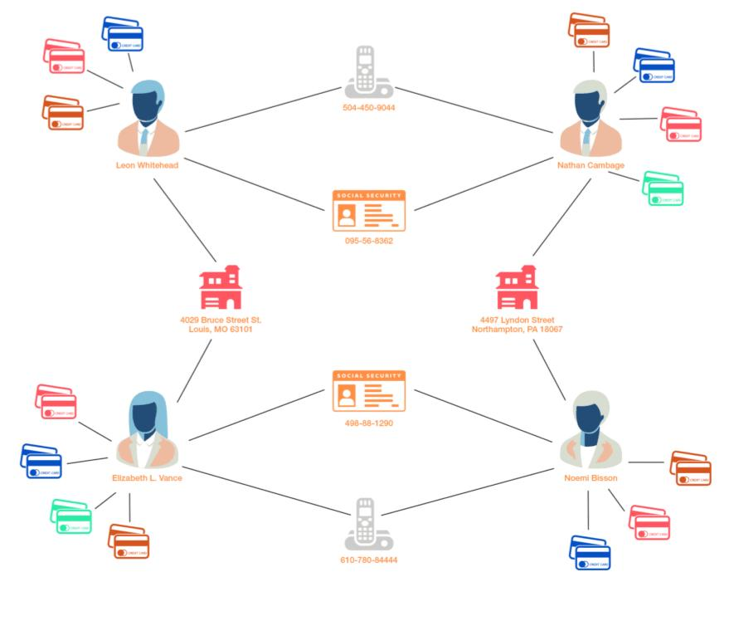
Graph-based Analysis
Transaction Networks: Create a graph where nodes represent credit card transactions, and edges represent relationships between transactions. Suspicious connections, such as multiple cards linked to a single address or a high number of transactions between a group of cards, can be identified.
Anomaly Detection: Use graph algorithms to identify anomalous nodes or edges in the transaction network.
Community Detection: Detect communities within the graph, which can represent groups of related transactions. Fraudulent activities often involve multiple cards or accounts, and community detection can help find such groups.
Temporal Analysis: Incorporate time-based information into the graph to identify patterns or trends in fraudulent activity over time. For example, sudden spikes in transactions can be a red flag.

Slide 3
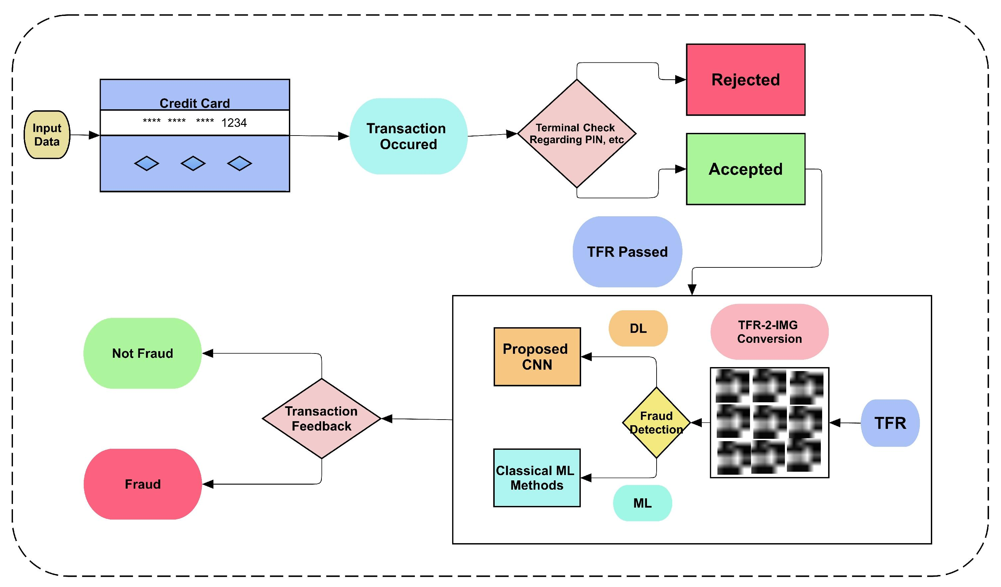
Natural Language Processing
Machine Learning: Employing various machine learning algorithms like logistic regression, decision trees, or more advanced techniques like random forests or neural networks to build models that can identify fraudulent transactions based on these features.
Customer Communications: Analyzing customer
interactions to identify fraud-related keywords or
phrases.
Text Data Analysis: Processing and understanding
text data from sources like customer complaints or
messages to detect potential fraud-related
information.
Reports and Documentation: Parsing and extracting
useful information from textual reports related to fraud cases.

Slide 4
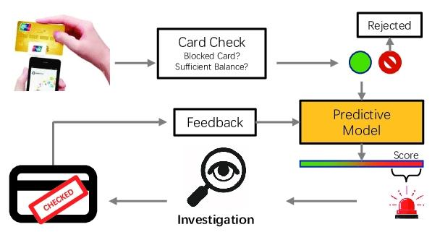
DEEP LEARNING MODELS
Convolutional Neural Networks (CNNs): CNNs can be
used to process and analyze image data, such as
scanned credit card images, or even to analyze patterns
In transaction graphs.
Recurrent Neural Networks (RNNs): RNNs can be
employed to model sequences of transactions to detect
unusual patterns or changes in user behavior over time.
Hybrid Models: Combinations of various deep learning
models can be used for more comprehensive fraud detection
systems. For example, using a combination of CNNs and LSTMs to process both image and sequential transaction data.
Auto encoders: Auto encoders can be used for dimensionality reduction and anomaly detection. They can help identify unusual patterns or outliers in credit card transactions.

Slide 5
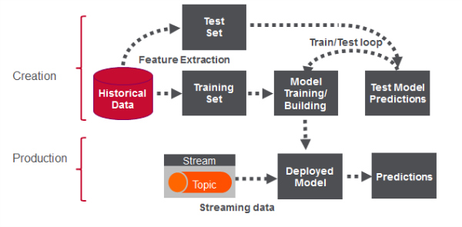
REAL TIME ANALYSIS
Data Collection: Gather transaction data from
various sources, including historical transaction
records, real-time transaction feeds, and customer
information.
Data Preprocessing: Clean and preprocess the
data to handle missing values, outliers, and
format it for analysis.
Monitoring: Continuously monitor the performance of the model and adjust the threshold and model as needed to adapt to changing fraud patterns.
Reporting and Alerts: Send alerts or notifications to relevant parties or institutions if a potentially fraudulent transaction is detected.

Slide 6
BLOCKCHAIN TECHNOLOGY
data Transparency and Immutability: blockchain’s decentralized ledger records all transactions in a transparent and immutable manner. This means that once a transaction is recorded, it cannot be altered.
Smart Contracts: Smart contracts are self-executing contracts with predefined rules. They can be used to automate various processes in credit card transactions, such as fraud detection and authorization.
Fraud Detection Algorithms: Data science techniques, such as machine learning, can be used to develop sophisticated fraud detection algorithms. These algorithms can analyze transaction data, user behavior, and other variables to identify unusual or suspicious patterns. The results can then be recorded on the blockchain for transparency.
Privacy Concerns: While block chain enhances security and transparency, it can also raise privacy concerns. Data science can be used to find a balance between transaction transparency and protecting user privacy.

Slide 7
USER CENTRIC APPROACHES
Anomaly Detection: Using statistical and machine learning techniques to identify transactions that deviate from normal spending behavior, which may be indicative of fraud.
Machine Learning Models: Employing supervised learning models like logistic regression, decision trees, or neural networks to classify transactions as either legitimate or fraudulent based on historical data.
Feature Engineering: Creating relevant features or variables from transaction data to improve model performance, such as transaction frequency, location, and purchase amount.
Feature Importance Analysis: Assessing the importance of various features in fraud detection models to refine the detection process.

